Slide 1


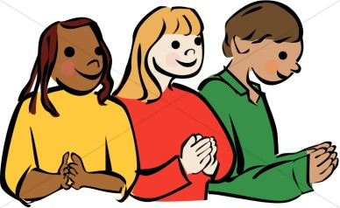
Welcome to Our Lady and St Joseph’s Sacramental Programme Meeting
https://www.youtube.com/watch?v=fCPhqBQURps&list=PLogouoksK9PhTID5fC1jCcBbZt-tJ1yCF

Slide 2
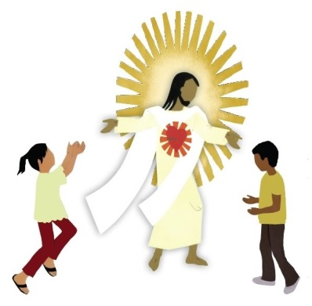
Mark 9:37
Whosoever shall receive one of such children in my name, receiveth me
All Baptised Catholic children in Year 3 are Welcome to make their First Holy Communion at St. Joseph’s (if your child is not Catholic and you would like them to make their First Holy Communion please speak to Father Augustine.
Mass at Church during school
Almost once a month on a Friday, they are invited to take part in Mass at Church to listen to the Word of God and understand the Order of the Mass.
The children may be invited to read.

Slide 3
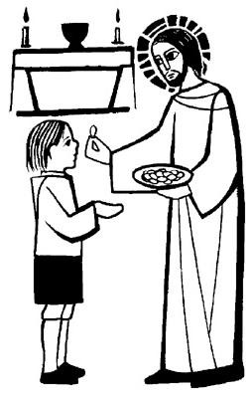
Sunday Mass
Children in Year 3 are also invited to Saturday or Sunday masses. During some of these masses, they will take an active part (Miss Martin will prepare). But in others, the children will just be part of the congregation and participate in Mass as normal.
At the end of Sunday Mass, Father Augustine will stamp the children’s books so that a record of attendance is kept.
The masses that the children have an active involvement in have been included in your folders.

Slide 4

The ‘I Belong’ Book
As part of the Sacramental Programme, children in Year 3 are expected to complete activities from the ‘I Belong’ book. This is taught during school time.
For each of the 10 chapters, there is a Family Time section which we would like you to complete with your child. Most activities will only take around 15 minutes at the most. An example of this is in your folder.
There is also a list of dates explaining when the children will complete the book. It also provides information explaining when the Family Time section needs to be completed by so that we can move onto the next chapter in school.
These dates have been included in your folder.

Slide 5

If you have any questions please ask Miss Martin or Father Augustine and we will do our best to answer them!

